Slide 1
Dynamic Allocation of UE-VBS in 5G Networks
Presented by :
Kanishkha LD –312217106068
Poojah G – 312217106112
Sneha S – 312217106161
Project Guide :
Dr. Kishore Rajendiran Associate Professor/ECE SSN College of Engineering
External Guide :
Dr Andreas Pitsillides
University of Cyprus

Slide 2
Outline
Objectives and Software implementation
Model of 5G cluster
K-Means Clustering algorithm
Mean shift Clustering
Communication Parameters used for UE-VBS selection
Basic block diagram for selection of UE-VBS
Results
Future scope

Slide 3
Objectives
To dynamically allocate User Equipment-Virtual Base Station (UE-VBS) in 5G Networks
By allocating UEs into clusters using suitable clustering algorithm and selection of VBS based on communication parameters.
Software requirements
MATLAB

Slide 4
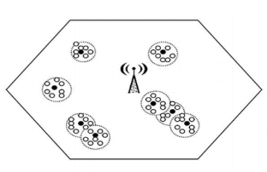
Model of 5G cluster
Several small cells are formed within a macro cell [1]. Each small cell is represented by a cluster.
The clusters are formed using K-Means clustering algorithm which takes in Euclidian distance as a parameter.
The communication parameters are calculated for all UEs in each cluster and a suitable VBS is selected.
This will increase the range of the 5G signal transmission and, thus, will also be available to UEs at the cell edges.

Slide 5
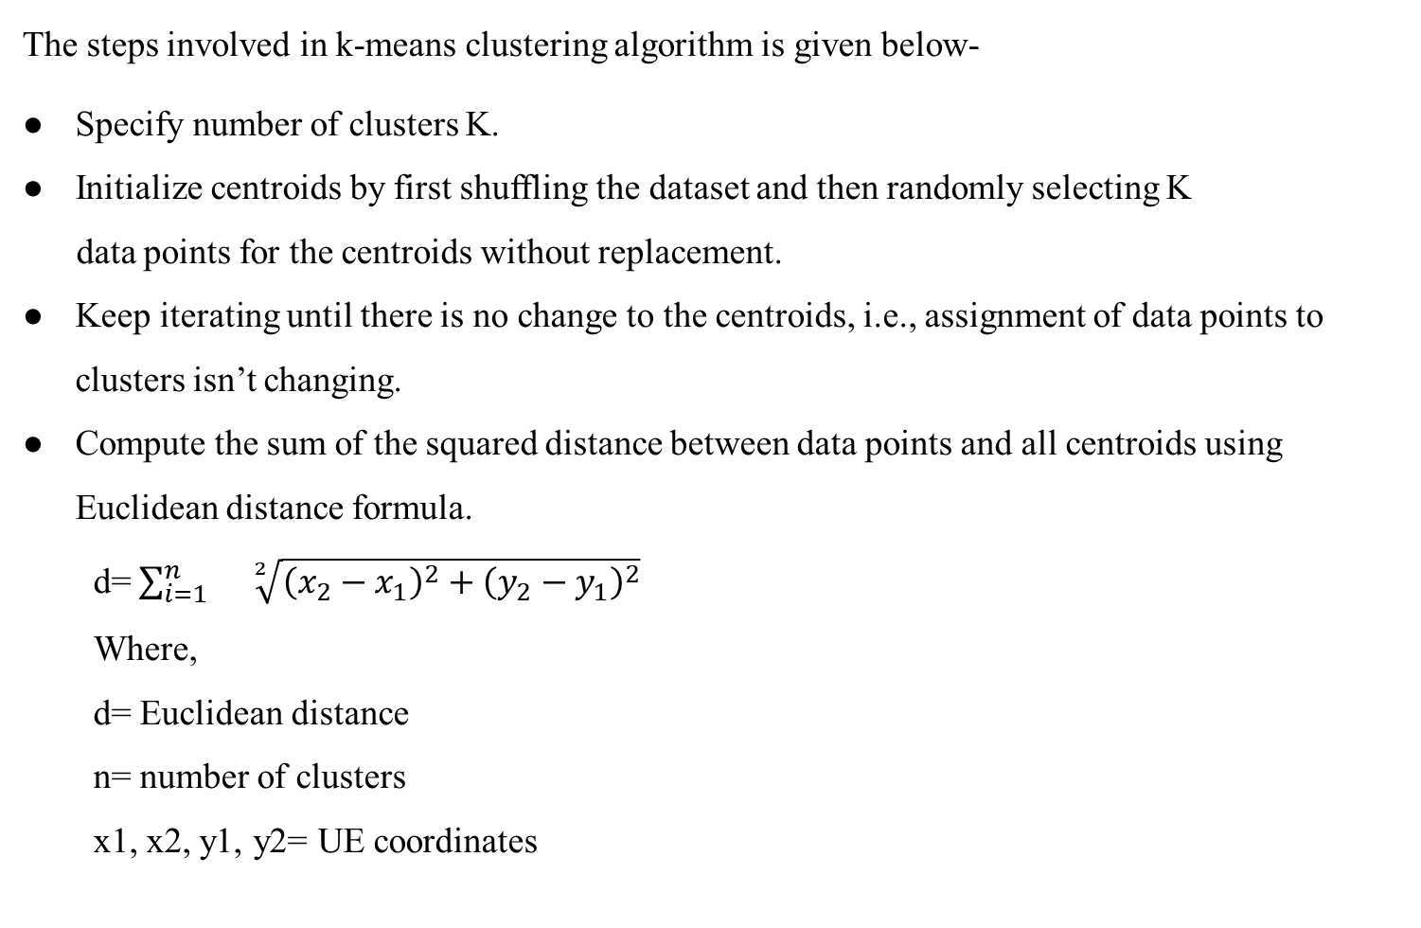
K-means clustering algorithm
The steps involved in k-means clustering algorithm is given below-
Specify number of clusters K.
Initialize centroids by first shuffling the dataset and then randomly selecting K
data points for the centroids without replacement.
Keep iterating until there is no change to the centroids, i.e., assignment of data points to clusters isn’t changing.
Compute the sum of the squared distance between data points and all centroids using Euclidean distance formula.
d=$\sum_{i=1}^{n}{}\sqrt[2]{{\left(x_{2}−x_{1}\right)}^{2}+{\left(y_{2}−y_{1}\right)}^{2}}$
Where,
d= Euclidean distance
n= number of clusters
x1, x2, y1, y2= UE coordinates

Slide 6
K-means clustering algorithm
Assign each data point to the closest cluster (centroid).
Compute the centroids for the clusters by taking the average of all data points that belong to each cluster.
The UEs are mobile nodes and thus at various intervals, their positions and movements are dynamic.
At a time t1, an UE, say UE1, can belong to cluster 1 but at time t2, it can belong to cluster 4. This is because clustering is done using K-means clustering algorithm which uses Euclidean distance to allocate UEs into different clusters.
The speed is randomly varied between 0 m/s to 10 m/s and angle between 10 to 350 degrees and these changes occur at a time interval of 20 s.

Slide 7
Mean shift clustering algorithm
Mean shift is a clustering algorithm in contrast of Unsupervised learning that assigns the data points to the clusters iteratively by shifting points towards the mode (highest density of data points in the region).
Mean-shift builds upon the concept of kernel density estimation (KDE). It is a method to estimate the underlying distribution also called the probability density function for a set of data. It works by placing a kernel on each point in the data set. A kernel is a weighting function generally used in convolution.
The steps involved in mean shift clustering algorithm is given below-
Initialize random seed and window W.
2. Calculate the center of gravity (mean) of W.
3. Shift the search window to the mean.
4. Repeat Step 2 until convergence.

Slide 8
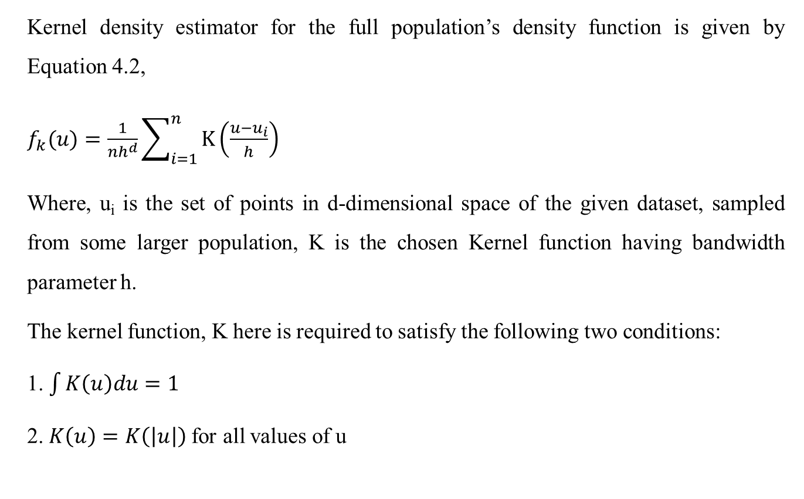
Mean shift clustering algorithm
Kernel density estimator for the full population’s density function is given by Equation 4.2,
$f_{k}(u)=\frac{1}{nh^{d}}\sum_{i=1}^{n}{K\left(\frac{u−u_{i}}{h}\right)}$
Where, u_{i} is the set of points in d-dimensional space of the given dataset, sampled from some larger population, K is the chosen Kernel function having bandwidth parameter h.
The kernel function, K here is required to satisfy the following two conditions:
1. $\int{K\left(u\right)du=1}$
2. $K\left(u\right)=K\left(\left|u\right|\right)$for all values of u

Slide 9
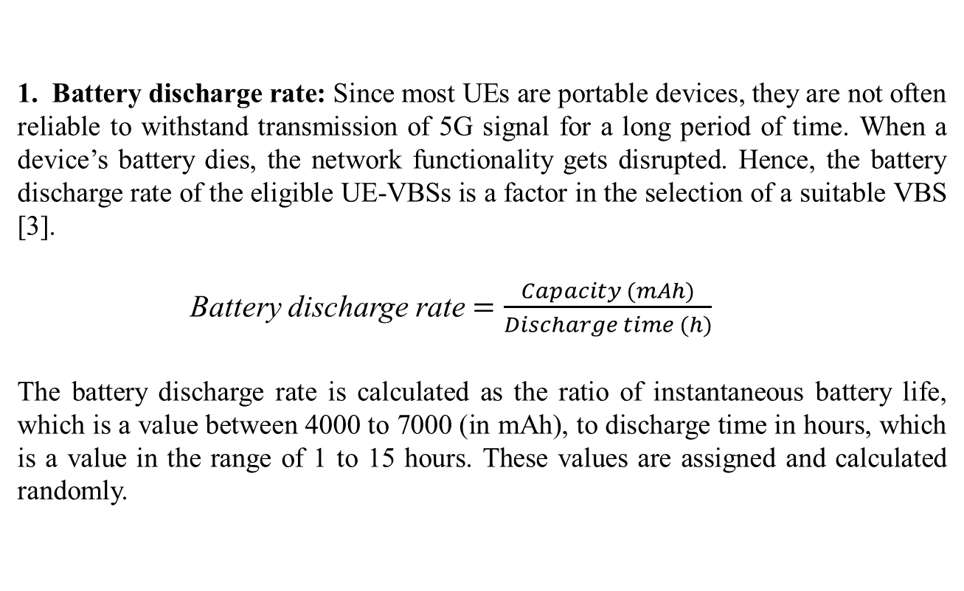
Communication parameters used for UE VBS selection
1. Battery discharge rate: Since most UEs are portable devices, they are not often reliable to withstand transmission of 5G signal for a long period of time. When a device’s battery dies, the network functionality gets disrupted. Hence, the battery discharge rate of the eligible UE-VBSs is a factor in the selection of a suitable VBS [3].
Battery discharge rate$=\frac{Capacity (mAh)}{Discharge time (h)}$
The battery discharge rate is calculated as the ratio of instantaneous battery life, which is a value between 4000 to 7000 (in mAh), to discharge time in hours, which is a value in the range of 1 to 15 hours. These values are assigned and calculated randomly.

Slide 10
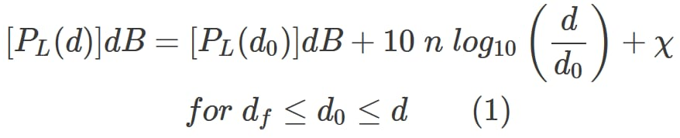
Communication parameters used for UE VBS selection
Power received by a UE from the BS: The Received Signal Strength (RSS) is an important factor as suggested in [2]. It is a measure of the signal strength with which UEs receive 5G connection from the BS. RSS is computed using the log normal path loss equation.
Where,
n = path loss exponent = 4
χ is a Gaussian random variable
d is the distance between Tx and Rx
PL(d₀) is reference path loss calculated using Frii’s free space formula

Slide 11
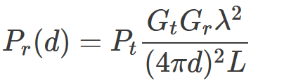
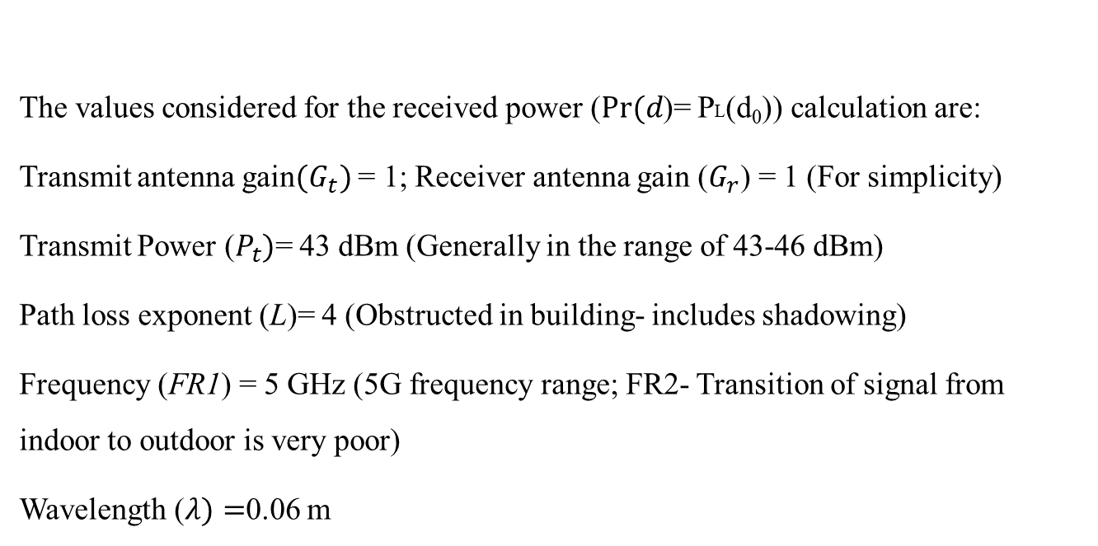
Communication parameters used for UE VBS selection
Frii’s free space formula:
PL(d₀)=
The values considered for the received power ($Pr⁡(d$)= PL(d₀)) calculation are:
Transmit antenna gain${(G}_{t})$ = 1; Receiver antenna gain ($G_{r}$) = 1 (For simplicity)
Transmit Power ($P_{t}$)= 43 dBm (Generally in the range of 43-46 dBm)
Path loss exponent (L)= 4 (Obstructed in building- includes shadowing)
Frequency (FR1) = 5 GHz (5G frequency range; FR2- Transition of signal from indoor to outdoor is very poor)
Wavelength ($λ)=$0.06 m

Slide 12
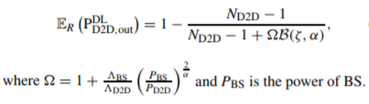

Communication parameters used for UE VBS selection
3. Outage Probability: It is the point at which the receiver power value falls below the threshold (where the power value relates to the minimum signal to noise ratio (SNR) within a cellular).
Outage Probability= P(SINR ⩽ λ^{th} )
The expected outage probability for a single-hop D2D link using DL resources [5] is obtained as:
is number density of Base Stations = 2/ (Area of the cell)
is the number density of UEs = (Number of UEs in one cluster-1)/ (Area of the cluster)
is the average SINR of the chosen cluster.

Slide 13
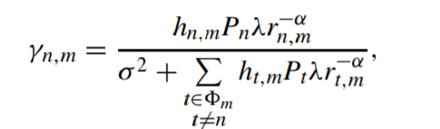
Communication parameters used for UE VBS selection
4. SINR: The signal-to-interference-plus-noise ratio (SINR) of a link from UE n to UE m is calculated using:
where
hn,m = fading power gain = 0.4292; rn,m = distance of the link from UE n to UE m
Pn = transmit power of UE n (depends on distance of UE, etc.)
λ = frequency dependent pathloss = 4 (For outdoor communication, path loss is independent of frequency); α = pathloss distance exponent= 4
m denotes the set of interferers to UE m, and σ2 is the additive white Gaussian noise (AWGN) power. The AWGN power is assumed to be negligible as compared to the interference power. [5]

Slide 14

Communication parameters used for UE VBS selection
5. SUM RATE:
UE level
The sum rate for individual UEs can be calculated using Shannon Capacity which is given by:
R = B log2 (1 + SINR) bps
Where,
R = Data rate
B = Channel Bandwidth= 100 MHz for 5G and 20 MHz for LTE
SINR = Signal to Interference plus Noise Ratio
ii) System level
The entire system’s sum rate is obtained using the formula given below:
where,
c-size = cluster size; SINR _{i} = SINR of i^{th} cluster
_{i} = Average SINR of i^{th} cluster

Slide 15

Communication parameters used for UE VBS selection
6. Quality of Service:
Quality of Service of the network is measured using Equation 5.8 which gives the Jain’s fairness index (JFI), where,
n is the number of users in the system at a particular instance of time,
յ(x₁,x₂, …., x_{n}) =
is the sample coefficient of variation of spectral efficiency, and

Slide 16
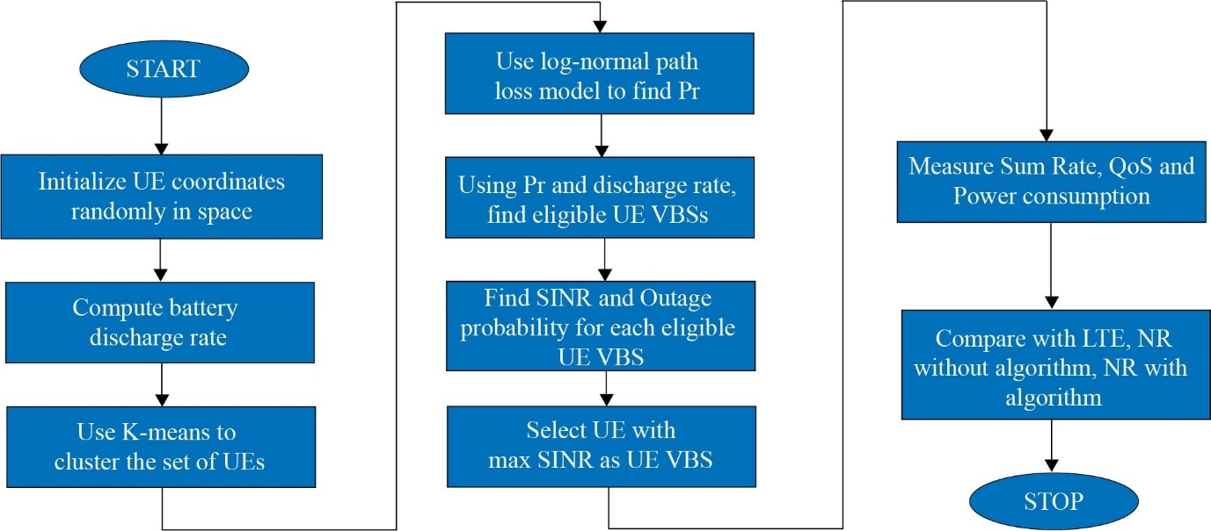
Basic block diagram for selection of UE-VBS

Slide 17
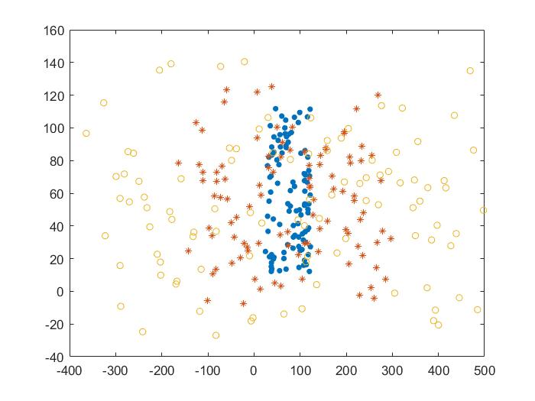
RESULTS
POSITIONING OF UEs FOR CLUSTER SIZE 4
Position of UE’s at time t1, t2 and t3
The UEs are positioned in a pseudo random manner at a time instant t1. After dt seconds, the positions of the UEs are arbitrarily changed by assigning random velocity to each UE for two other time instances t2 (t1+dt) and t3 (t1+2 x dt).

Slide 18
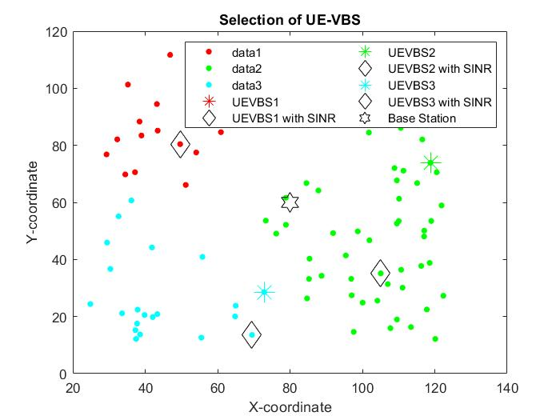
RESULTS
POSITIONING OF UEs FOR CLUSTER SIZE 4
Selection of UE VBS for cluster size 3, at time t1
From each cluster, the algorithm selects an UE to act as a VBS using power received, battery discharge rate and SINR, for cluster size 3 at time instance t1.

Slide 19
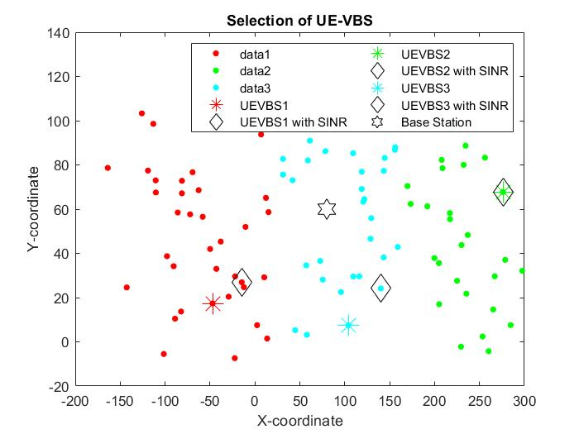
RESULTS
POSITIONING OF UEs FOR CLUSTER SIZE 4
Selection of UE VBS for cluster size 3, at time t2
From each cluster, the algorithm selects an UE to act as a VBS using
power received, battery discharge rate and SINR, for cluster size 3 at
time instance t2.

Slide 20
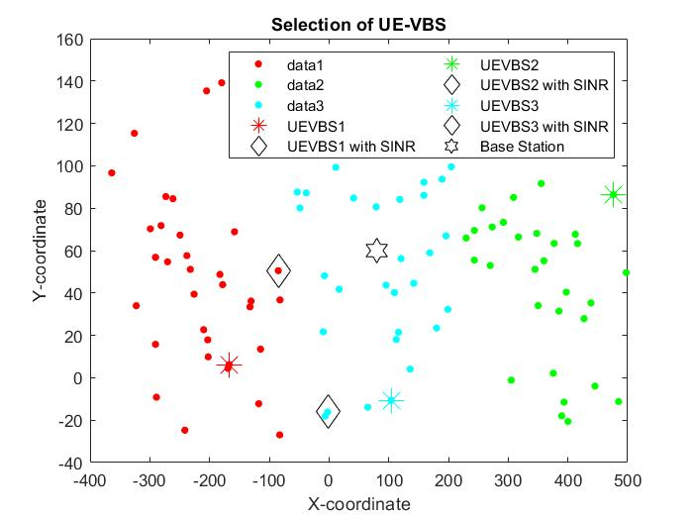
RESULTS
POSITIONING OF UEs FOR CLUSTER SIZE 4
Selection of UE VBS for cluster size 3, at time t3
From each cluster, the algorithm selects an UE to act as a VBS using power received, battery discharge rate and SINR, for cluster size 3 at time instance t3.

Slide 21
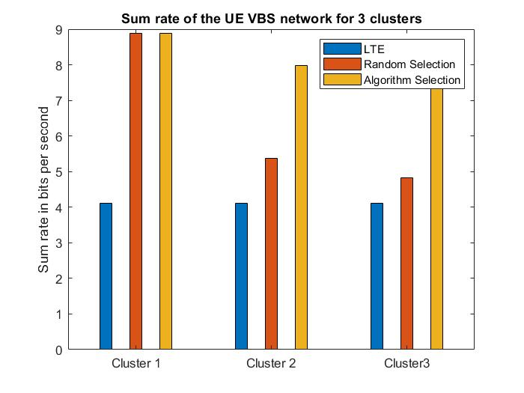
RESULTS
PERFORMANCE ANALYSIS FOR VARIOUS CLUSTER SIZES
Sum rate of UE VBS for cluster size 3
The average sum rate for each cluster is computed using the Shannon-Hartley theorem
for an UE VBS selected by the proposed algorithm against an UE VBS selected at random
(and for an LTE base station) for cluster size 3 as shown in the Figure.

Slide 22
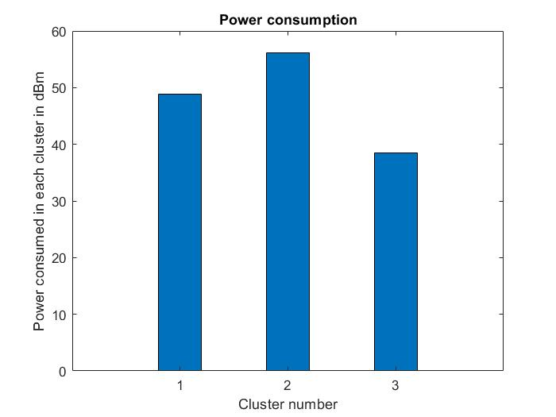
RESULTS
PERFORMANCE ANALYSIS FOR VARIOUS CLUSTER SIZES
Power Consumption of UE VBS for cluster size 3
The power consumption in each cluster is computed using the difference between transmitted and received powers between the UEs, Base Station and UE-VBS, selected at using the algorithm for cluster size 3, as shown in the Figure

Slide 23
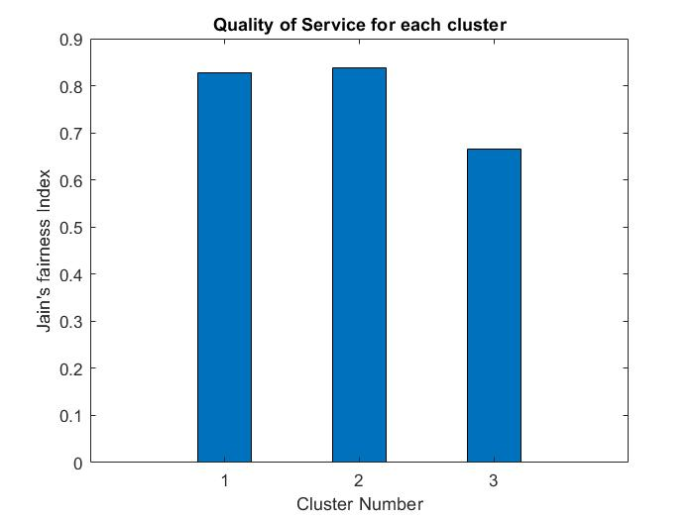
RESULTS
PERFORMANCE ANALYSIS FOR VARIOUS CLUSTER SIZES
QoS of UE VBS for cluster size 3
From Figure, it is observed that QoS values are close to 1 in each cluster, for cluster size 3. Thus, it can be inferred that all the UEs receive a good quality 5G connection. Hence, applications like streaming, video calls and gaming experiences will match the satisfactory levels.

Slide 24
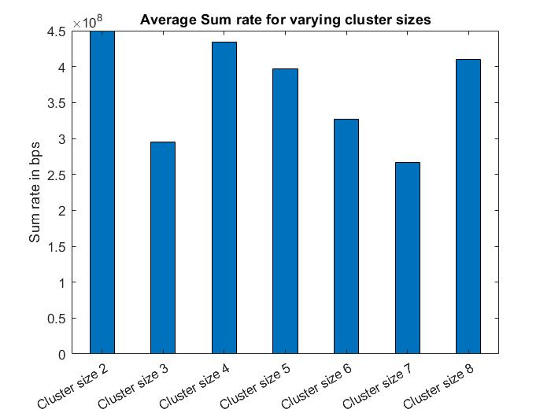
RESULTS
SYSTEM PERFORMANCE INFERENCE
Average sum rate for varying clusters
The average sum rate for the system with different cluster sizes is plotted. Performance of
the system with cluster size 2 is neglected since it might lead to underfitting. Since the
availability of UE VBS in each cluster is dynamic, the cluster size can be chosen to fit the
necessary requirements, ideally 3, 4 or 8 in this case.

Slide 25
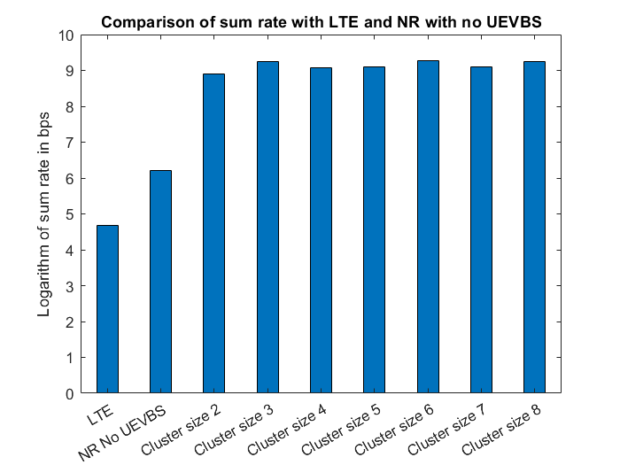
RESULTS
SYSTEM PERFORMANCE INFERENCE
Comparison of average sum rate with LTE and NR with no UEVBS
The throughput of an LTE system and that of a 5G system with no UE VBS is plotted along
with the throughput of various 5G UE VBS systems with varying cluster sizes, above.
It can be inferred that the usage of 5G UE VBSs shows a significantly better system performance
than the other mentioned systems.

Slide 26
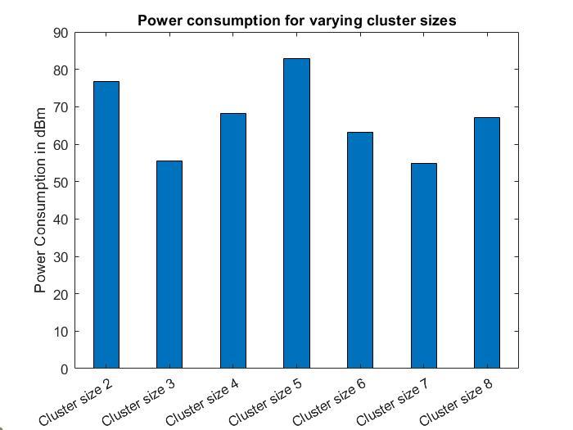
RESULTS
SYSTEM PERFORMANCE INFERENCE
Comparison of average power consumption for different cluster sizes
From fig, it can be inferred that cluster size 5 has the highest cumulative power consumption compared to the other cluster sizes. Hence, it would not be a suitable choice for cluster size. The power consumption across the various sizes varies due to the geographical distribution of the UEs in each cluster. This parameter, along with Quality of Service and Sum Rate, can be effectively used to determine the number of clusters which can operate, at the most ideal behaviour, for a 5G UE-VBS network.

Slide 27
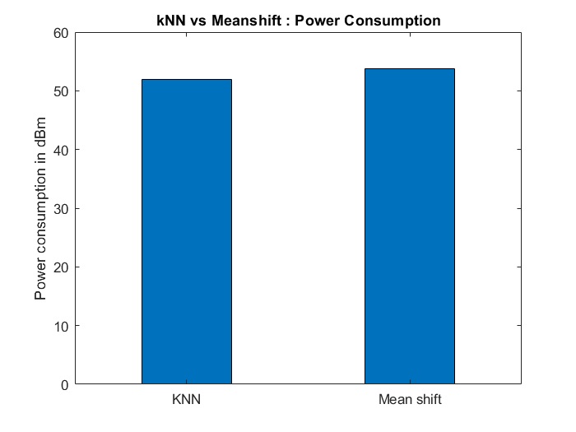
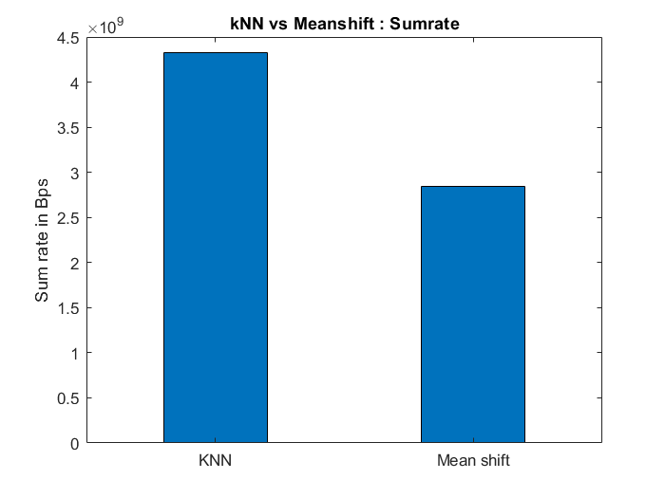
RESULTS
SYSTEM THROUGHPUT INFERENCE
Comparison of average sum rate for k-NN and Mean shift clustering methods
.
Comparison of average power consumption for k-NN and Mean shift clustering methods
From the above figures, it can be proved that k-NN is a better approach than mean shift as it provides better sum rate and has lesser power consumption

Slide 28
FUTURE SCOPE
The project can be extended to include the phenomenon of co-channel interference from other base stations and UEs from other cells. The frequency range of the signals can be changed to the FR2 range of frequencies where concepts like Massive MIMO will play a major role in the selection of UE VBS.
The reliability of the UE VBS cannot be predicted with the current selection algorithm as any user might have malicious intent and can cause severe privacy risks for all the other UEs in the small cell. The information loss/theft due to the rogue UE VBS can be a criminal offence of the highest order. To avoid this, the Base Station should select the UE VBS in an intelligent manner with the help Artificial Intelligent tools.

Slide 29
References
[1] Ian F. Akyildiz, Shuai Nie, Shih-Chun Lin, Manoj Chandrasekaran ‘5G Roadmap: 10 Key enabling technologies’ (2016), Computer Networks 106 pp. 17-48.
[2] Siyi Wang, Weisi Guo, Zhenyu Zhou, Yue Wu, and Xiaoli Chu ‘Outage Probability for Multi-Hop D2D Communications With Shortest Path Routing’ (2015), IEEE Communications Letters, Vol. 19, NO. 11
[3] Zhenyu Zhou, Mianxiong Dong, Kaoru Ota, Member, Jun Wu, and Takuro Sato ‘Energy Efficiency and Spectral Efficiency Tradeoff in Device-to-Device (D2D) Communications’ (2014), IEEE Communications Letters, Vol. X, NO. X
[4] Pravati Swain, Christophoros Christophorou , Upasana Bhattacharjee , Cristiano M. Silva , Andreas Pitsillides ‘Selection of UE-based Virtual Small Cell Base Stations using Affinity Propagation Clustering’ (2018), IWCMC

Slide 30
THANK YOU

